Slide 1

UnitySpace: Interactive Community Hub
Welcome to UnitySpace a comprehensive platform designed to foster a vibrant and connected community. It provides a secure interactive space for residents to engage and share information and build meaningful relationships.

Slide 2
Problem Statement
Missed Information:
Delayed updates
Lack of Engagement:
Paper notices often get lost or overlooked leading to residents missing out on vital community news.
Email communications can be unreliable with messages ending up in spam folders or going unread.
Traditional methods often fail to create a sense of community and encourage active participation.

Slide 3

A Comprehensive Solution
Centralized Hub
Enhanced Accessibility
UnitySpace provides a single platform for all community related information
Residents can access information anytime anywhere through their mobile devices or computers..
Interactive Features
UnitySpace encourages active participation in events and share their response.

Slide 4

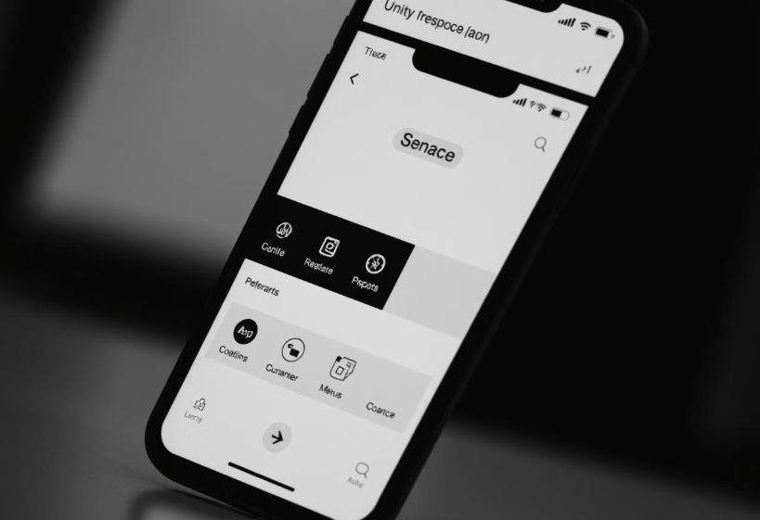
Key Features: Streamline Community Engagement
Centralized Community Calendar
Resident Profile
Keep track of all community events meetings and deadlines in one easy to use calendar.
Residents gets insights about their activity in the platform.

Slide 5
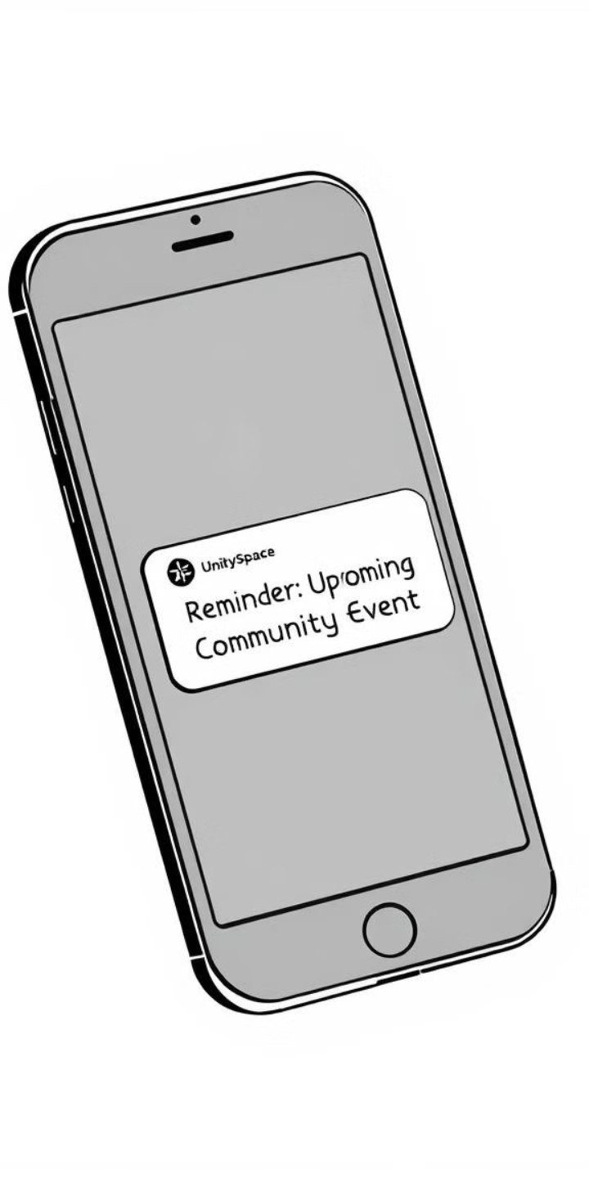



Integrated Notification System
Instant Communication
Send urgent messages or updates about the events to residents instantly.
Targeted notifications
Filter the notification based on the user interests for efficient delivery.
Emergency Response
Utilize the platform to quickly inform residents in case of emergencies.

Slide 6
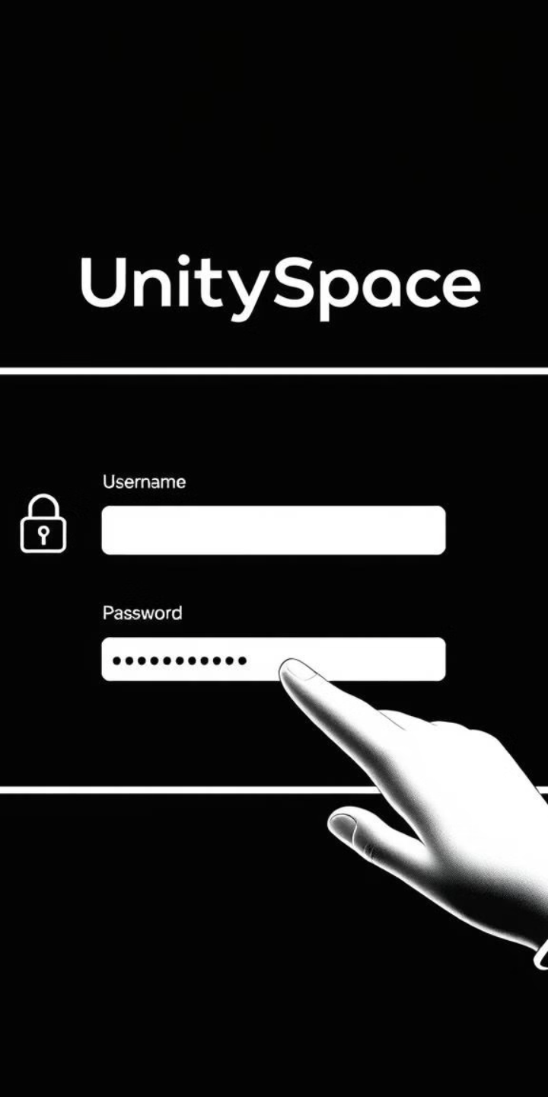
User Authentication and Admin Approval
1
Secure Login
2
Admin Approval
Users are required to create strong passwords and secure their accounts.
All new users require approval from administrators before gaining access.
3
Phone Validation
Users select country phone code
Phone numbers must match the country-specific length

Slide 7
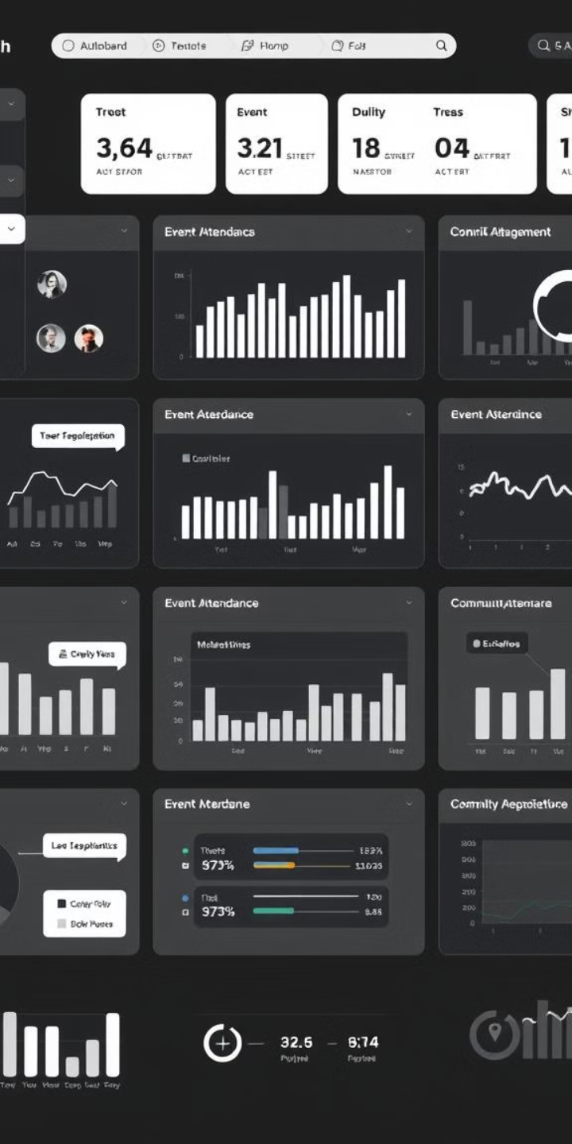
Dashboards for Users and Administrators
User Dashboard
Event Updates
Updating profile
Admin Dashboard
User Management
Event Analytics
Community Insights

Slide 8




Event Feedback and Commenting Features
Positive Feedback
Commenting
Schedule
Users can share their positive experiences about the website.
Users can comment on the events and share their thoughts.
Provides a simple way to schedule events and reminders in a calendar.

Slide 9
Automated Event Reminders with Java Schedulers
We have utilized Java Schedulers to ensure timely reminders for upcoming events. Users receive notifications 30 minutes before the event start time. The reminders are sent through multiple channels, including calls, SMS, and emails, providing a seamless notification experience. This enhances engagement and ensures no event is missed.

Slide 10
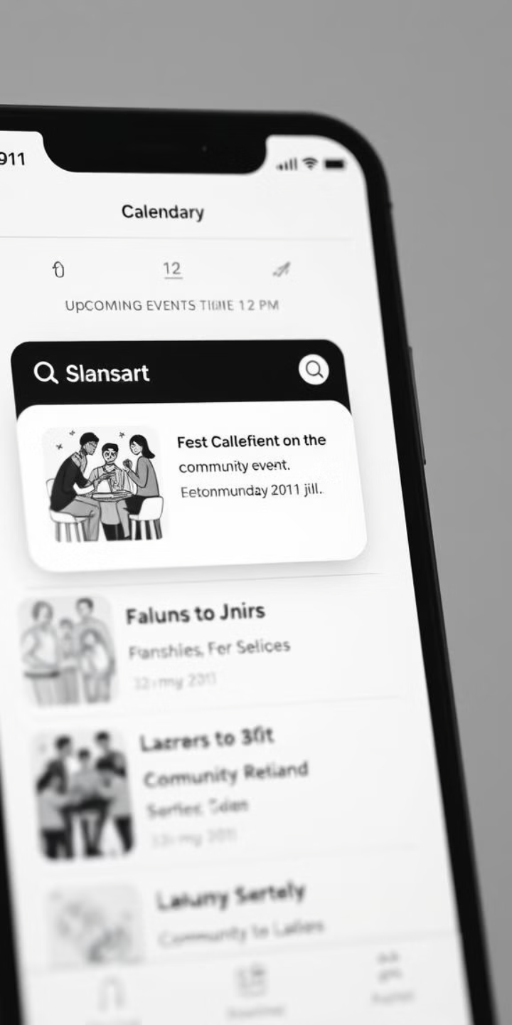
Reminder Service for Resident Engagement
1
Event Scheduling
The Reminder Service is triggered when a new event is created or updated.
2
Reminder Generation
Users can set preferences for receiving reminders via SMS, email, or voice calls.
3
Resident Engagement
The Reminder Service ensures that residents are kept informed about upcoming events and activities.

Slide 11

Tech Stack :
Frontend:
Backend:
React
Java SpringBoot
Tailwind CSS
Mongo Db
Aceternity UI
Jwt Authentication
Bootstrap
Schedulers

Slide 12
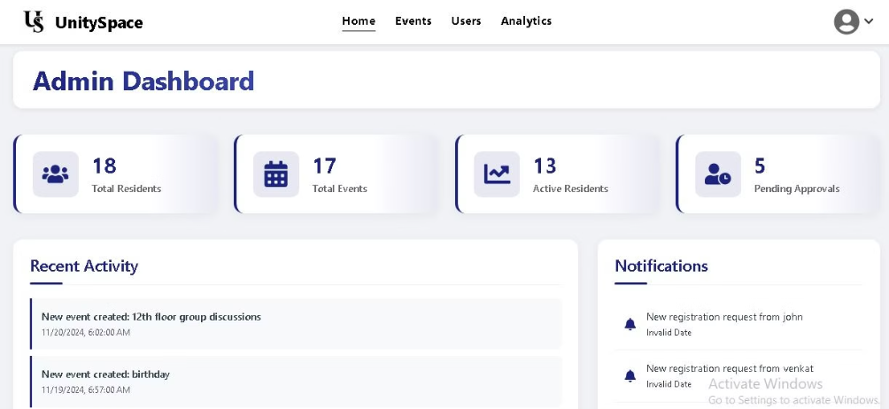
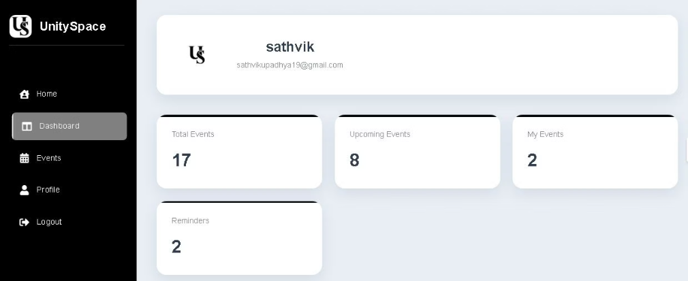
Snapshots

Slide 13

Conclusion and Key Features Overview
UnitySpace offers a comprehensive platform for building a strong and engaged community.
It provides a secure, interactive space for residents to connect and communicate and stay informed about local events.
Key features include a robust microservices architecture,
A user-friendly UI,
A secure login system,
Event feedback and commenting,
A reminder service for resident engagement.

